Slide 1






Discovering gganimate: Lessons learnt
@rhetta_chappell

Slide 2

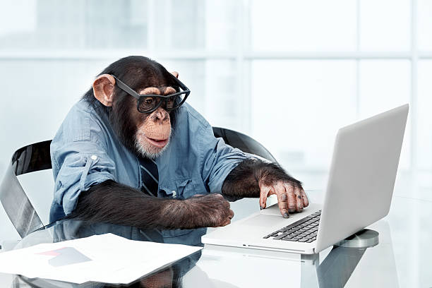
Data Analytics Web Developer Regional Innovation Data Lab Griffith University
@rhetta_chappell

Slide 3
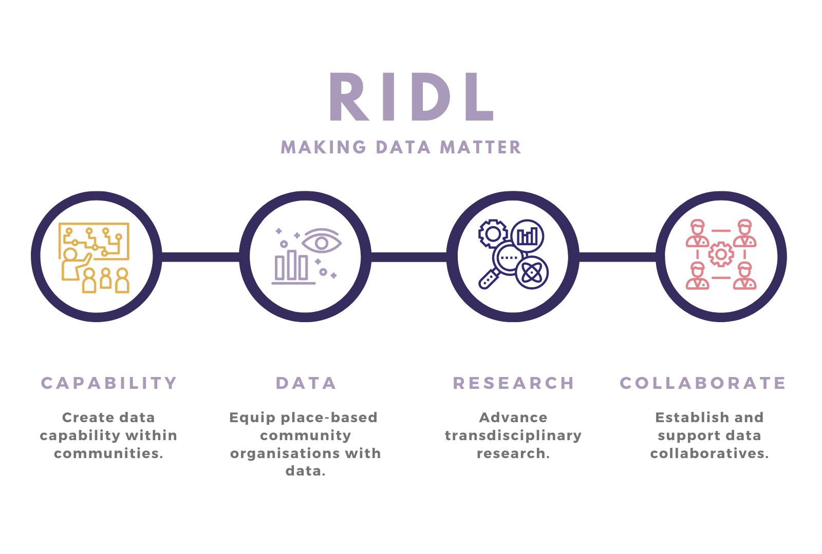

Slide 4


Before we get started….
THANK YOU
RLADIES for the OPPORTUNITY
I am not an expert,
but I love to Learn and share.
Assuming basic understanding
ggplot & Grammar of graphics
@rhetta_chappell

Slide 5
Outline
Brief intro
Key FEATURES
3 Lessons
Resources
Questions
@rhetta_chappell

Slide 6
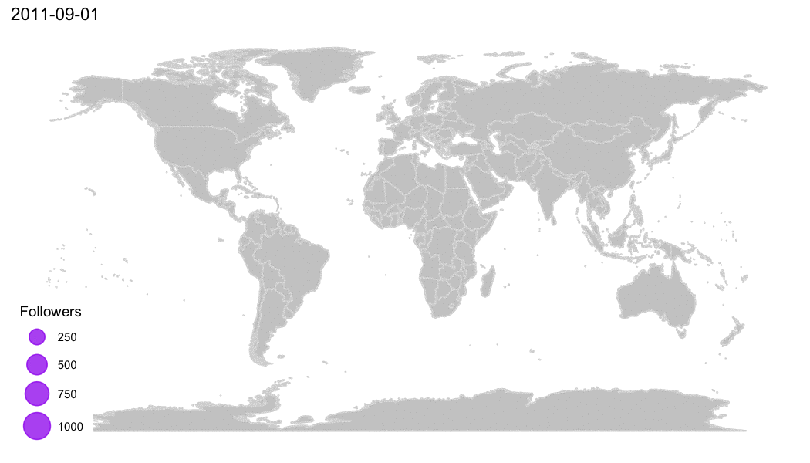
How to install gganimate
gganimate stable version is available on CRAN and can be installed with install.packages('gganimate’)
The latest development version can be installed as follow: devtools::install_github('thomasp85/gganimate').
Animation from: https://d4tagirl.com/2017/05/how-to-plot-animated-maps-with-gganimate

Slide 7
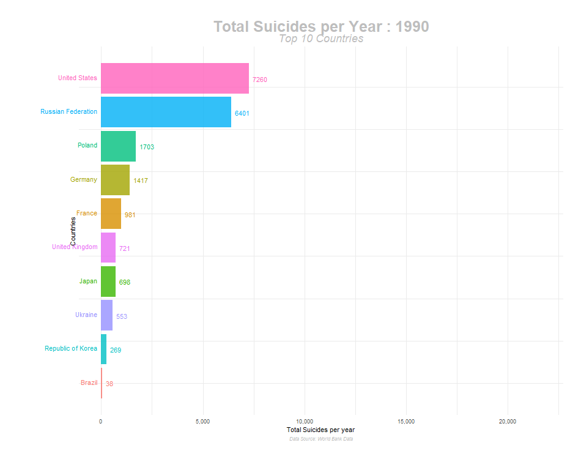
When should you animate?
Data must contain a suitable variable to drive animation e.g.
Changes over time
Changes over iterative/recursive techniques
Changes during a simulation
@rhetta_chappell
Animation from: https://towardsdatascience.com/how-to-create-plots-with-beautiful-animation-using-gganimate-912f4279b073
Notes:
The key point here is to highlight important changes in the data over the variable which is driving the animation.

Slide 8
What does gganimate do?
"...gganimate, extends the grammar of graphics as implemented by ggplot2 to include the description of animation. It does this by providing a range of new grammar classes that can be added to the plot object in order to customise how it should change with time".
- https://gganimate.com/
@rhetta_chappell

Slide 9
What does gganimate do?
"When we animate data visualisations we often do it by calculating intermediary data points resulting in a smooth transition between the states represented by the raw data. In gganimate this is done by adding a transition which defines how data should be expanded across the animation frames".
https://www.data-imaginist.com/2018/what-are-we-plotting-what-are-we-animating/
@rhetta_chappell

Slide 10
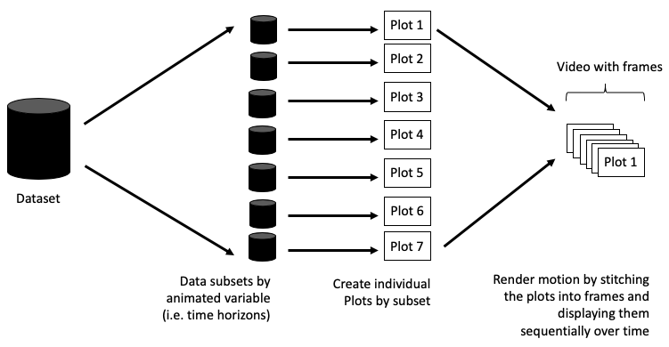
How does gganimate work?
@rhetta_chappell
Diagram from: https://towardsdatascience.com/animating-your-data-visualizations-like-a-boss-using-r-f94ae20843e3

Slide 11
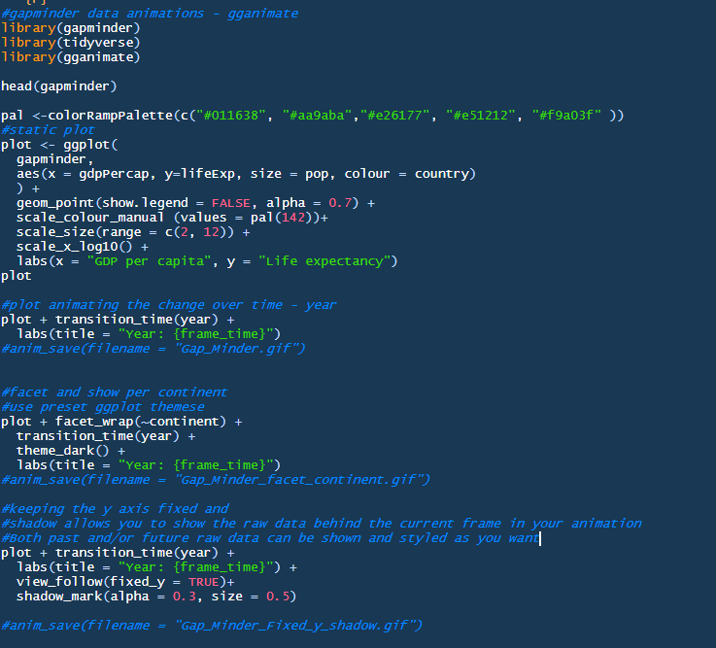
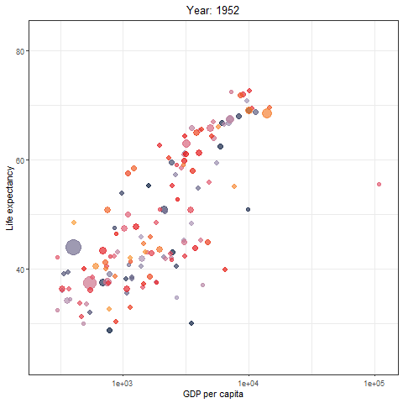
Static plot to animated plot in 1 line of code

Slide 12
Key features of gganimate:
1. Transitions
transition_ *: this function defines how data should be spread and how it relates to itself over time.
transition_time: the transition length between the states is set to correspond to the actual time difference between them.
transition_reveal: this allows you to let the data gradually appear.
transition_state: this is used to animate the plots by categorical or discrete variables.
transition_components: allows each graphic element to animate through its own time series – visual components have their own ‘life cycle’
@rhetta_chappell
Notes:
Transitions are functions that interpret the plot data in order to somehow distribute it over a number of frames. We want to calculate the intermediary data states that ensure smooth transitions between states – also referred to as tweening.
Based on the descriptions provided in the documentation and my first simple exploration of gganimate I thought I knew which transition to choose right away but this actually took me a couple of tries and this had to due with the nature of my data. I will talk about this a bit more when I get to the 3 lessons.
transition_components()
This transition allows individual visual components to define their own "life-cycle". Transition_components instead allows each graphic element to animate through its own time series: This means that the final animation will not have any common "state" and "transition" phase as any component can be moving or static at any point in time. uses the group aesthetic of each layer to identify which rows in the input data correspond to the same graphic element and will therefore define stages in time that the element will animate through.

Slide 13
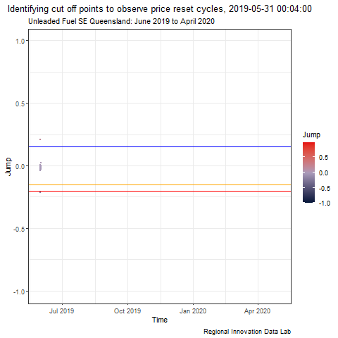
Key features of gganimate:
2. Object permanence
Group aesthetic: Data that have the same group aesthetic are interpreted as being linked across states. The group aesthetic defines how the data in a layer is matched across the animation.
@rhetta_chappell

Slide 14
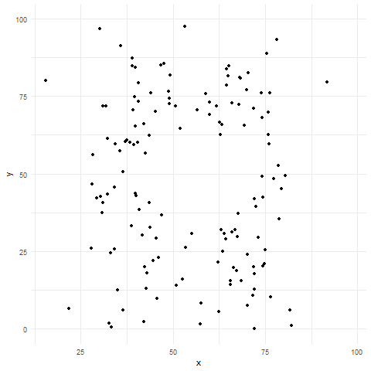
Key features of gganimate:
3. Easing
ease_aes(): it describes how the different aesthetics should be eased during animation. How the animation moves from one value to another.
ease_aes(“cubic-in-out”)
ease_aes(“sine-in-out”)
@rhetta_chappell
Animation from: https://towardsdatascience.com/animating-your-data-visualizations-like-a-boss-using-r-f94ae20843e3

Slide 15
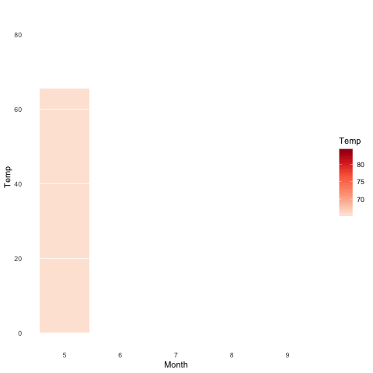
Key features of gganimate:
4. Enter/Exit
enter_*/exit_ *: it is used to determine how new data should be appearing and old data disappearing during the animation process.
enter_fade/exit_shrink/enter_grow/exit_fade
@rhetta_chappell
Animation from: https://www.datanovia.com/en/blog/gganimate-how-to-create-plots-with-beautiful-animation-in-r/
Notes:
These functions are responsible for modifying the state of appearing (entering) and disappearing (exiting) data, so that the animation can tween from and to the new state.

Slide 16
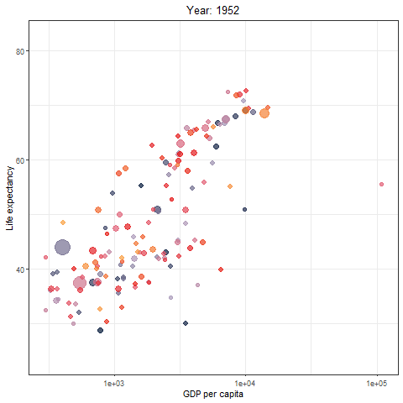
Key features of gganimate:
Example = view_follow(fixed_y=TRUE)
5. View
view_ *: It is used to define how the x & y axes should change along with the animation or stay fixed.
view_follow(fixed_y=TRUE): This means that the y_axis would be fixed when the animation is running.
view_follow(fixed_x=TRUE) : the x-axis would be fixed as the animation runs.
@rhetta_chappell

Slide 17
Key features of gganimate:
6. Rendering
Computing the final output:
nframes: it sets the number of frames to be used (default is 100 remember thin data with low # frames might not be right to animate).
Frames per second(fps): this is the amount of time spent on each frame per second(default is 10)
Renderer: this sets the function for combining each frame into an animate (default renderer = gifski_renderer()).
Can also use an av or mp4 renderer to put to .mp4 (video) instead of .gif
renderer=ffmpeg_renderer()
Duration – total time for animation duration = 25
Layout – specify height and width
Do we want the .gif to play on a loop or stop after animation ends?
Default renderer= gifski_renderer(loop= TRUE )
You can also set an amount of time for the animation to pause before restarting
@rhetta_chappell

Slide 18
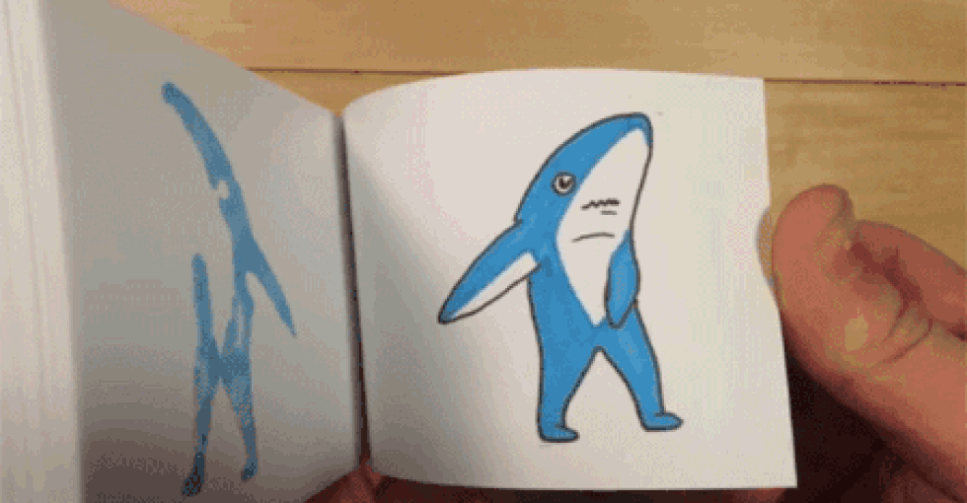
Lesson #1
Have a clear plan:
As always, get to know your data
Sketch out the different frames/ states for your animation (remember its kinda like an old school cartoon flip book)
Read documentation or find a similar online examples
Get your static plot ready to go before trying to animate
@rhetta_chappell

Slide 19
Lesson #2
Transition_time() doesn’t work if you have a non-continuous time variable – repeated times
Example: Project brief – illustrate changes in price within a set series of time components geographically and temporally
transition_time() - but it didn’t work due to non unique time/dates
transition_components() – to iterate through the unique time series for each of the price surges but this wasn’t quite right
transition_reveal() – was the winner in the end for what I needed to reveal data gradually you can also set cumulative = TRUE in a few of the other transition_* to build data up on your plot.
@rhetta_chappell

Slide 20
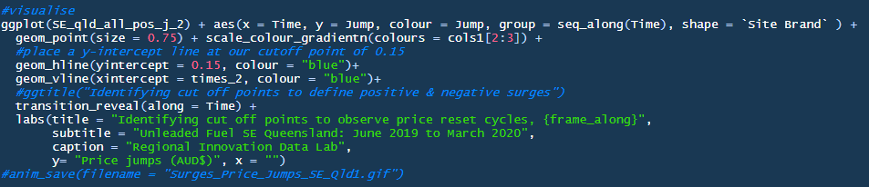
Lessons #3 & 3.5
When using transition_reveal() to show data gradually appearing use the group aesthetic and you can keep points by giving them a unique group using: group = seq_along(grouping_var)
Pay attention to the labels - gganimate makes the variables in the transition available for string literal interpretation – the wording changes depending on the tranition_* used
@rhetta_chappell
Notes:
Pay attention to the labels - gganimate makes the variables in the transition available for string literal interpretation. The exact wording changes from transition to transition. Error messaging doesn't always make it obvious so always check this if you're getting an error and can't see why.
frame_time
(transition_time(), transition_components())
frame_along
(transition_reveal())

Slide 21
Code for the gap minder animations. Adapted from tutorial: https://www.datanovia.com/en/blog/gganimate-how-to-create-plots-with-beautiful-animation-in-r/

Slide 22
Resources
Getting Started:
GGplot:
https://ggplot2.tidyverse.org/
Grammar of graphics:
https://amzn.to/2fncG50
GGanimate:
https://gganimate.com/
R & RLadies:
https://rladies.org/
Blogs/Tutorials:
https://www.datanovia.com/en/blog/gganimate-how-to-create-plots-with-beautiful-animation-in-r/
https://towardsdatascience.com/animating-your-data-visualizations-like-a-boss-using-r-f94ae20843e3
https://towardsdatascience.com/how-to-create-plots-with-beautiful-animation-using-gganimate-912f4279b073
@rhetta_chappell

Slide 23
Thank you!
How to get in touch:
www.ridl.com.au
r.chappell@griffith.edu.au
Twitter: @rhetta_chappell

